Slide 1

AIM
TO ACQUAINT THE CLASS ABOUT MICROSOFT EXCEL 2021

Slide 2
WHAT IS MS EXCEL
Excel is a spreadsheet application developed and published by Microsoft. It is part of the Microsoft Office suite of productivity software.
Unlike a word processor, such as Microsoft Word, Excel organizes data in columns and rows. Rows and columns intersect at a space called a cell. Each cell contains data, such as text, a numerical value, or a formula.
Excel was originally code-named Odyssey during development. It was first released on September 30, 1985.

Slide 3
VERSIONS OF MS EXCEL
Windows versions
Excel 2021, Oct 05, 2021
Excel 2019, released in 2018
Office 365 and Excel 2016, released in 2016
Excel 2013, released in 2013
Excel 2010, released in 2010
Excel 2007, released in 2007
Excel 2003, released in 2003
Excel 2002, released in 2002
Excel 2000, released in 2000
Excel 97, released in 1997
Excel 95, released in 1995
Excel 5.0, released in 1993
Excel 4.0, released in 1992
Excel 3.0, released in 1990
Excel 2.0, released in 1987
Excel 2008, released in 2008
Excel 2004, released in 2004
Excel 2001, released in 2001
Excel 2000, released in 2000
Excel 98, released in 1998
Excel 5.0, released in 1993
Excel 4.0, released in 1992
Excel 3.0, released in 1990
Excel 2.2, released in 1989
Excel 1.5, released in 1988
Excel 1, released in 1985
Mac versions
Excel 2021, Oct 05 2021
Excel 2019, released in 2018
Excel 2016, released in 2016
Excel 2011, released in 2011

Slide 4
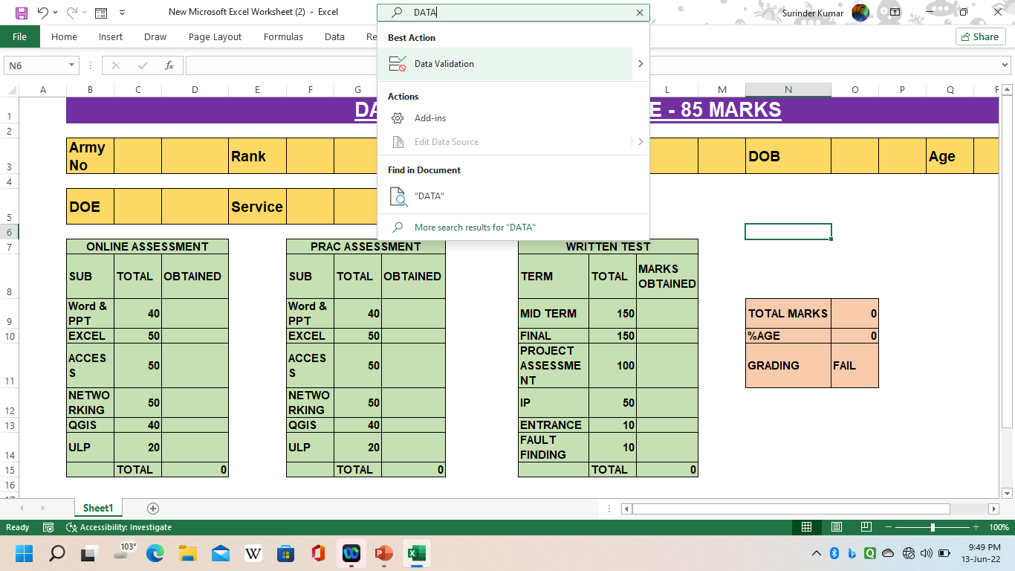
NEW WAY TO ISSUE COMMAND
This option add in Excel 2016 for the first time.
In Excel 2021 LTSC (Long Term Service Channel) offers yet another way to issue command: Tell me what you want to do box.
Situated in the UPPER PART of the ribbon tab
Use this when you are unsure of where to find the command

Slide 5

HOW TO OPEN MS EXCEL
START BUTTON
RUN COMMAND – EXCEL– ENTER
DESKTOP - RIGHT CLICK OF MOUSE– NEW – MICROSOFT EXCEL

Slide 6
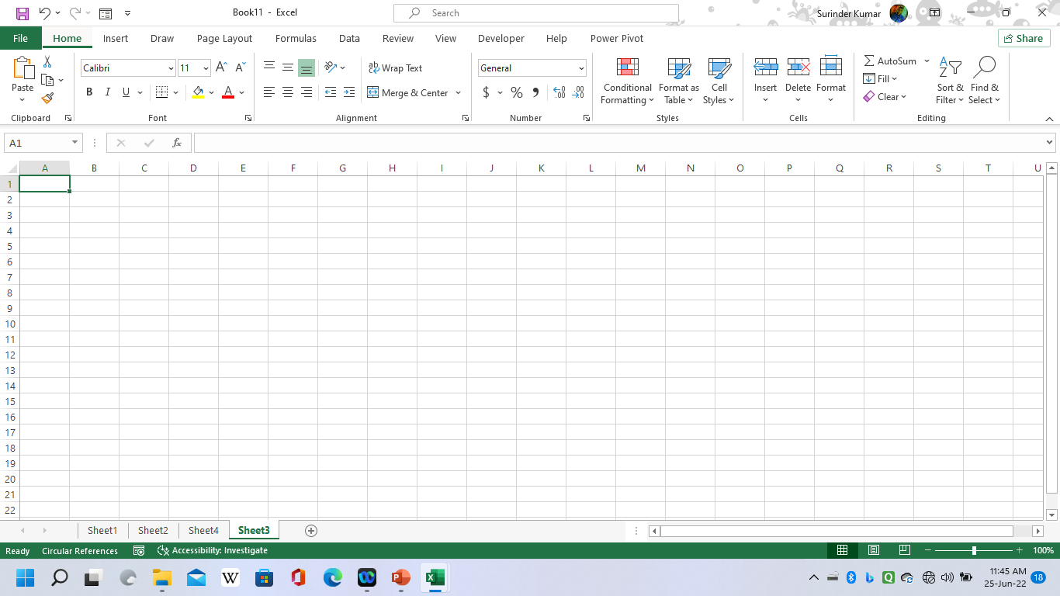
File Menu
Formula Bar
Restore Button
Name Box
Column
Row
Cell Pointer
Vertical Scroller
Horizontal Scroller
Page Break Preview
Sheet Tab

Slide 7
INTRODUCTION
Microsoft excel is spreadsheet application developed by Microsoft for Microsoft windows and mac OS
Application software of MS office & one worksheet like a graph page
Mathematical calculation solved by easy method
Excel 2013 supports up to 1 million rows and 16 thousand columns per worksheet
The excel 2013 grid is 10,48,576 rows by 16,384 columns
Total no of cells 17,17,98,69,184 cells in one work sheet

Slide 8
ADVANTAGES OF MS EXCEL
It helps in doing calculations
It helps in making charts
It helps in formatting
Best way to store data
You can perform calculations
All the tools for data analysis
Easy to data visualizations with charts
You can print reports easily
So many free templates to use
You can code to automate
Transform and clean data
Store data with millions of rows
You can work with Excel online + mobile app

Slide 9
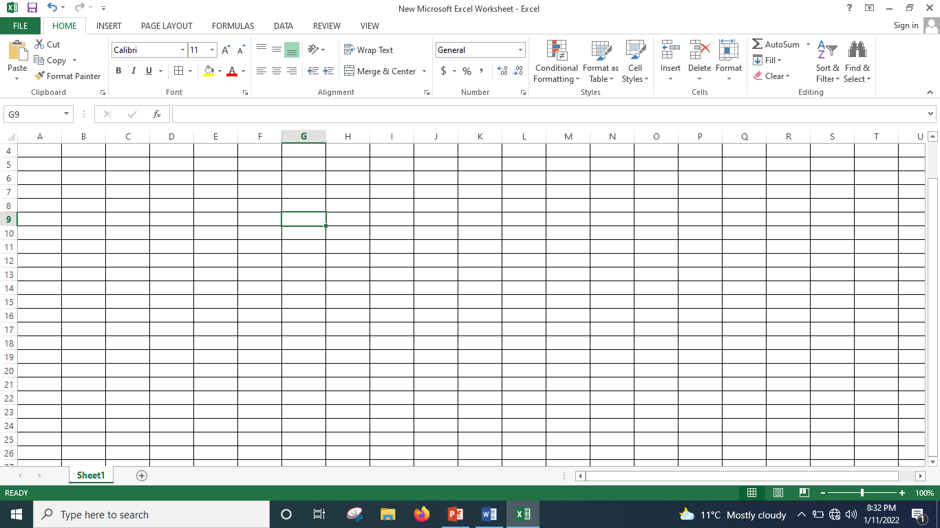
WHAT IS WORKSHEET
Worksheet like a page, spreadsheet
Primary document
By default, Microsoft office Excel 2021 LTSC provides one worksheets in a workbook
By default, the name is sheet1 and +, but you can give any worksheet a more appropriate name

Slide 10
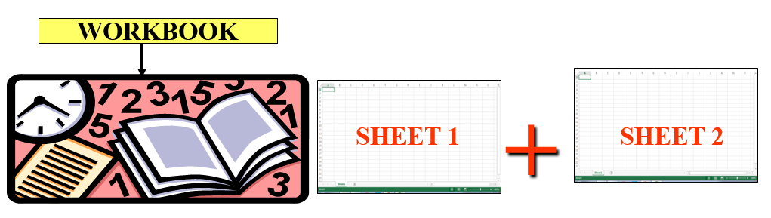
WHAT IS WORKSHEET
A file that contains one or more worksheets.
Workbook is a collection of worksheets.
Workbook is a multi-page excel document.

Slide 11
WHAT IS GRIDLINES
Those horizontal and vertical lines are crossed to each other and divide a worksheet into rows and columns are called gridlines
We can merge the gridlines
We cannot do sorting and indexing after merge the gridlines

Slide 12
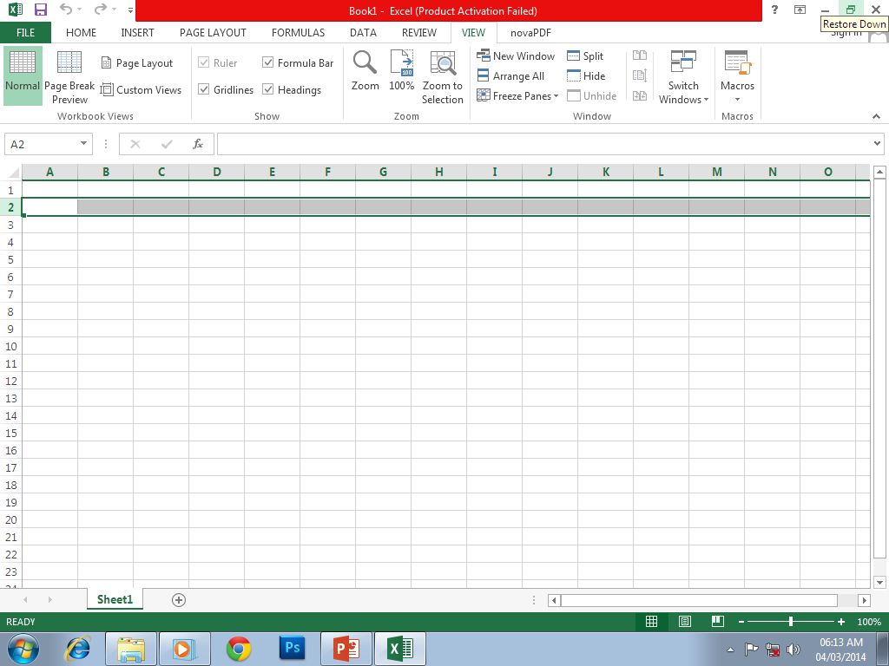
WHAT IS ROW
The horizontally group of cells is called row
Default height of row is 15.00 pts
By default, 1, 2, 3… labels denoted to number of rows in a sheet
Total no of rows in a single worksheet is 10, 48,576
There is no change in total no of rows after insert or delete a new row
Height and width of rows can be changed in a worksheet
We can hide, unhide and freeze pane a row
We cannot change the label of row

Slide 13
WHAT IS COLUMN
Vertical group of cells is called a column
Column denoted by alphabet labels up to XFD
Total no of columns in a single worksheet is 16,384
There is no change in total no of columns after insert a new column
By default, column width is 8.43 pts
Column width can be increased and decreased according to data

Slide 14
WHAT IS CELL
Small size boxes in excel sheet is called a cells in which data can be enter
Size of cells can be increases according to data size
Total cells in a worksheet 17,17,98,69,184
There is no change of total cells in worksheet after inserting a new cells
Cells can be merge two or more horizontal or vertical cells

Slide 15
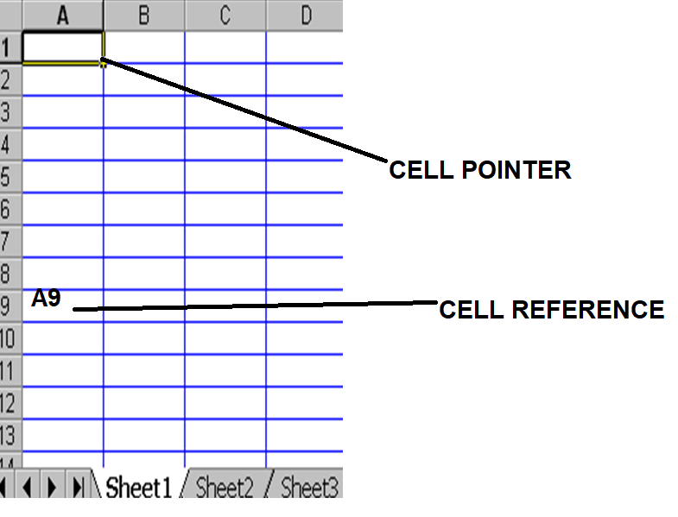
CELL POINTER & CELL REFERENCE
CELL POINTER: A rectangle high-light into the left corner of
worksheet.
CELL REFERENCE:
        It is a co-ordination of row and column.
        It shows the location of cells in a worksheet.
        It can be used in one cells or range of cells.

Slide 16
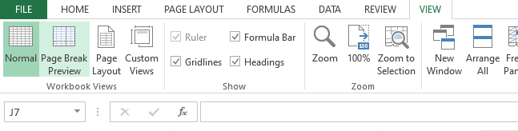
FORMULA BAR
A bar at the top of the excel window.
Use to enter or edit values or formulas in cells or charts.
Displays the constant value or formula stored in the active cell.
Formula bar can be resize by CTRL + SHIFT+ U.
You can hide and unhide the formula bar.
You can change its height (expand it), but you can’t change its position.

Slide 17
IMPORTANT TIPS & TERMS
Default file name | Book1
Default font | Calibri
Default font size | 11
Default zoom | 100%
Default pointer location | A1
Default open sheet | Sheet1
Run command | Excel
Total tab | 07
Minimum font size | 1
Maximum font size | 409
Minimum zoom | 10%
Maximum zoom | 400%
Total no of column | A to XFD (16,384)
Total no of row | 10,48,576
Total no of cell | 17,17,98,69,184
Password encryption | 255 character
File extn | .xlsx

Slide 18
PASTE SPECIAL
Paste command always used to paste the copy data from one document to other or in the same document.
But in excel, any data which is stored in excel contain so many different thing (like formatting, formulas, data validation, conditional formatting etc)
When we copy the data from excel sheet, some time we need to paste only data of that copied data except all other things.
At that time paste special command is become very useful
Paste special option provide different option to paste the data as per reqmt.

Slide 19
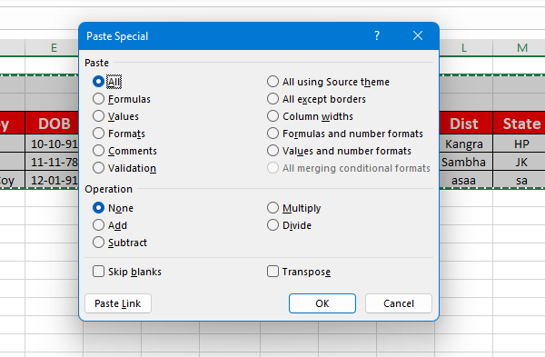
PASTE SPECIAL

Slide 20
PASTE SPECIAL
All | Pastes all cell contents and formatting of the copied data.
Formulas | Pastes only the formulas of the copied data as entered in the formula bar.
Values | Pastes only the values of the copied data as displayed in the cells.
Formats | Pastes only cell formatting of the copied data.
Comments and Notes | Pastes only comments and notes attached to the copied cell.
Validation | Pastes data validation rules for the copied cells to the paste area.
All using Source theme | Pastes all cell contents in the document theme formatting that is applied to the copied data.
All except borders | Pastes all cell contents and formatting applied to the copied cell except borders.
Column widths | Pastes the width of one copied column or range of columns to another column or range of columns.
Formulas and number formats | Pastes only formulas and all number formatting options from the copied cells.
Values and number formats | Pastes only values and all number formatting options from the copied cells.
All merging conditional formats | Pastes the contents and conditional formatting options from the copied cells.

Slide 21
PASTE SPECIAL
None | Specifies that no mathematical operation will be applied to the copied data.
Add | Adds the copied data to the data in the destination cell or range of cells.
Subtract | Subtracts the copied data from the data in the destination cell or range of cells.
Multiply | Multiplies the copied data with the data in the destination cell or range of cells.
Divide | Divides the copied data by the data in the destination cell or range of cells.
Skip blanks | Avoids replacing values in your paste area when blank cells occur in the copy area when you select this check box.
Transpose | Changes columns of copied data to rows and vice versa when you select this check box.
Paste Link | Click to create a link to the copied cell(s).

Slide 22
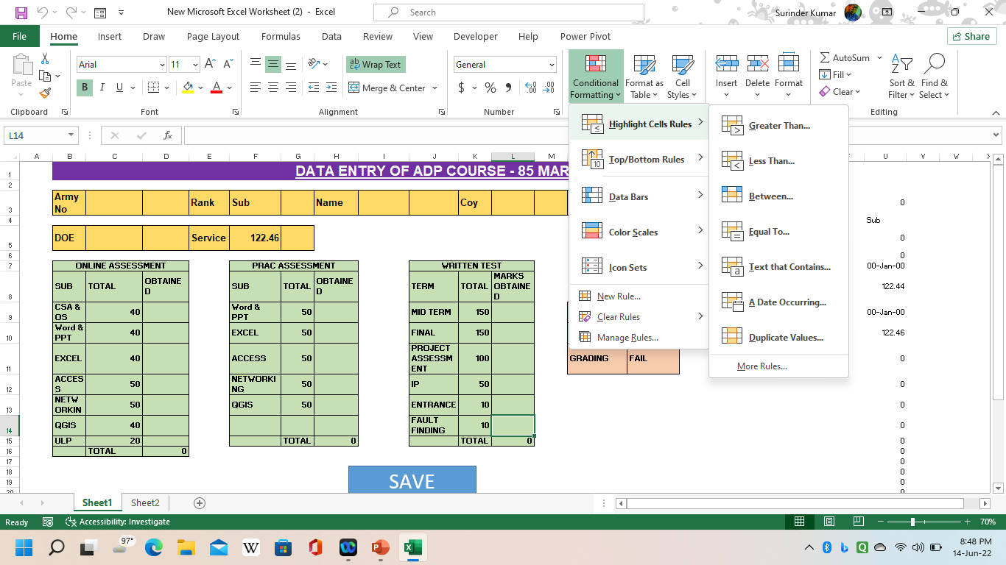
CONDITIONAL FORMATTING
Conditional formatting formula provides the functionality to highlight cells with a certain color, depending on the cell’s value or a specific condition.
It is a fantastic way to quickly visualize data in an excel sheet. By conditional formatting rules in Excel, you can highlight data with provided criteria.
Conditional formatting options allow you to apply different formatting options, such as background colour, borders, or font formatting to data that meets certain conditions.
A cell can have up to 3 format conditions, each with its own formats, in addition to the default value of "no formatting". This allows you to have different formats depending on the value of the cell.

Slide 23
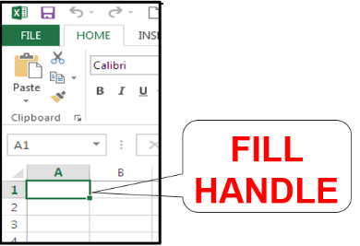
AUTO FILL
FILL HANDLE : The small black square in the lower-right corner of the selection. When you point to the fill handle, the pointer changes to a black cross.

Slide 24
AUTO FILL
Fill series: The fill series command is a command in excel sheet which enables you to open the series dialog box. This dialog box then enables you to enter values into many cells with just a few clicks.
Linear: Creates a series that is calculated by adding the value in the step value box to each cell value in turn.
Growth: Creates a series that is calculated by multiplying the value in the step value box by each cell value in turn.
Date: Creates a series that fills date values incrementally by the value in the step value box and dependent on the unit specified under date unit.

Slide 25
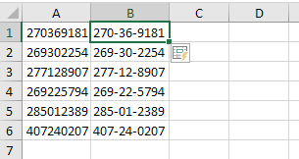
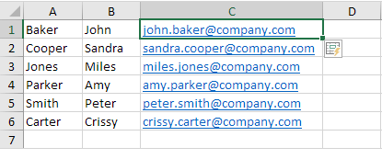
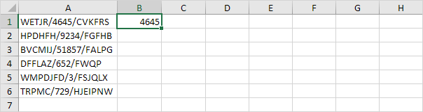
FLASH FILL
Flash Fill automatically fills your data when it senses a pattern
For example, you can use Flash Fill to separate first and last names from a single column, or combine first and last names from two different columns
Flash Fill is only available in Excel 2013 and later. Windows/ Mac OS

Slide 26
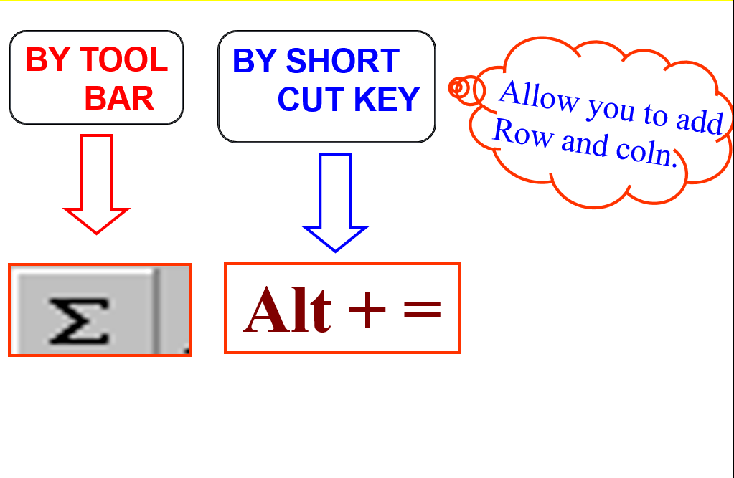
AUTO SUM

Slide 27
PIVOT TABLE
A pivot table is a tool in data summation that is common in many business software. It is utilized to collect the summary of a specific data set in a compressed technique.
They let the user make a faster organization and drawing of conclusions from data being collected.
Pivot table consists of columns, rows, pages, and data fields.
These can be moved around and it assists in expanding, isolating, summarizing, and grouping the specific data. And all of these can be accomplished in real time.
A pivot table is a special Excel tool that allows you to summarize and explore data interactively
A pivot table allows you to extract the significance from a large, detailed data set.
A Pivot Table is a tool which is used to store the summary of a large data set in a condensed manner.
Pivot Table enables the user to view the differences in a very big set of information.
It is very helpful in organizing a large amount of data in Microsoft Excel.

Slide 28
ADVANTAGE OF PIVOT TABLE
Pivot Tables are user-friendly
Pivot tables can create instant data
Pivot Table makes data analysis easier
Pivot table summarizes data easily
Pivot table assists in finding data patterns
Pivot table creates accurate reports faster
Pivot tables can help in making decisions faster

Slide 29
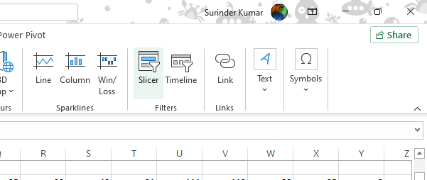
SLICER
Slicers are visual form of filters. Using a slicer, you can filter your data (or pivot table, pivot chart) by clicking on the type of data you want.
Slicers are available only in Excel 2010 and above

Slide 30
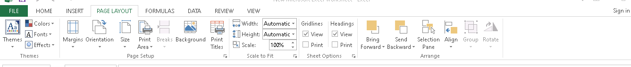
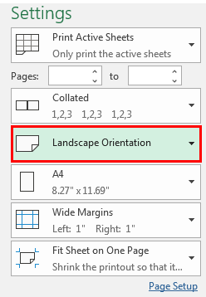
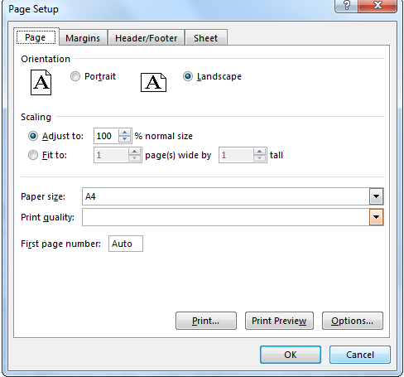
PAGE SETUP AND PRINTING EXCEL WORKSHEET

Slide 31
FORMULAS & FUNCTIONS
FORMULAS
In Excel, a formula is an expression that operates on values in a range of cells or a cell. For example, =A1+A2+A3, which finds the sum of the range of values from cell A1 to cell A3.
A formula is an expression which calculates the value of a cell. Formula is made by user as per reqmt.
FUNCTION
Functions are predefined formulas in Excel. They eliminate laborious manual entry of formulas while giving them human-friendly names. For example: =SUM(A1:A3). The function sums all the values from A1 to A3.
Functions are predefined formulas and are already available in Excel.
There is another term that is very familiar to Excel formulas, and that is "function". The two words, "formulas" and "functions" are sometimes interchangeable. They are closely related, but yet different. A formula begins with an equal sign. Meanwhile, functions are used to perform complex calculations that cannot be done manually. Functions in excel have names that reflect their intended use.

Slide 32
FORMULA
OPERATORS:
Operators a sign or symbol. The specific type of calculation to perform within an expression. There are mathematical, comparison, logical and reference.
  Arithmetic operators
  Comparison operators
  Text concatenation operators
  Reference operators

Slide 33
ARITHIMETIC OPERATOR
ARITHMETIC OPERATOR | MEANING | EXAMPLE
+ (PLUS SIGN) | ADDITION | 9+8
– (MINUS SIGN) | SUBTRACTION | 9-8
* (ASTERISK) | MULTIPLICATION | 9*8
/ (FORWARD SLASH) | DIVISION | 9/8
% (PERCENT SIGN) | PERCENT | 15%

Slide 34
COMPARISON OPERATOR
COMPARISON OPERATOR | MEANING | EXAMPLE
= (EQUAL SIGN) | EQUAL TO | A1=B1
> (GREATER THAN SIGN) | GREATER THAN | A1>B1
< (LESS THAN SIGN) | LESS THAN | A1<B1
>= (GREATER THAN OR EQUAL TO SIGN) | GREATER THAN OR EQUAL TO | A1>=B1
<= (LESS THAN OR EQUAL TO SIGN) | LESS THAN OR EQUAL TO | A1<=B1
<> (NOT EQUAL TO SIGN) | NOT EQUAL TO | A1<>B1

Slide 35
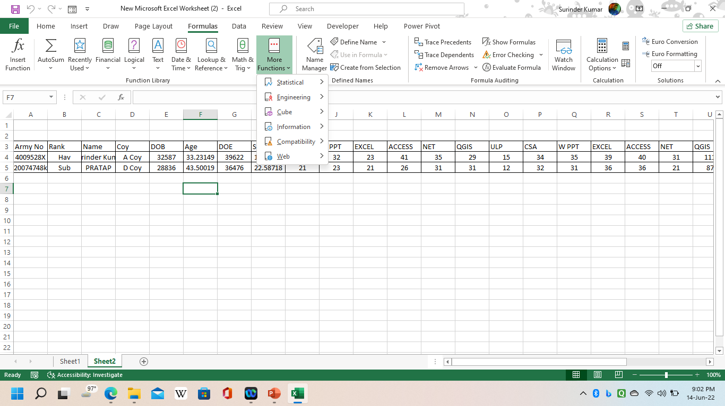
TYPE OF FUNCTION
DATE & TIME FUNCTION.
TEXT FUNCTION.
LOGICAL FUNCTION.
LOOKUP & REFERENCE
MATH & TRIGONOMETRY
MORE FUNCTION
  Statistical
  Engineering
  Cube
  Information
  Compatibility

Slide 36
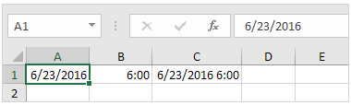
DATE & TIME FUNCITON
To enter a date in Excel, use the "/" or "-" characters. To enter a time,
use the ":" (colon). You can also enter a date and a time in one cell.

Slide 37
DATE & TIME FUNCTION
NAME OF FUNCTION | SYNTAX | USE
DATEDIF | =DATEDIF(CELLREF, CELLREF,”Y”) | GET RESULT YEAR
DATEDIF | =DATEDIF(CELLREF, CELLREF,”YM”) | GET RESULT MONTH
DATEDIF | =DATEDIF(CELLREF, CELLREF,”MD”) | GET RESULT DAYS
TODAY | =TODAY() | TODAY'S DATE
NOW | =NOW() | CURRENT DATE AND TIME
 | CTRL + ; (SEMICOLON). | CURRENT DATE AS A STATIC VALUE
 | CTRL + SHIFT + : (SEMICOLON). | CURRENT TIME AS A STATIC VALUE
AGE | =(NOW()-DOB)/365.25 =DATEDIF(A2,TODAY(),”y”) | TO CALCULATE AGE/SERVICE
Int | =INT((TODAY()-30.4073)) | PREV MONTH DATE
Int | =INT((TODAY()+ 30.4073)) | NEXT MONTH DATE

Slide 38
MATHEMATICAL FUNCTION
SUM | =SUM(CELL RG:CELL RG) | FOR ADDITION
AVERAGE | =AVERAGE(CELL RG:CELL RG) | FOR AVERAGE
MAX | =Max(Cell Rg:Cell Rg) | MAXIMUM
MIN | =Min(Cell Rg:Cell Rg) | MINIMUM
COUNT | =COUNT (CELL RG:CELL RG) | TO COUNT NUMERIC VALUE CELL
COUNTA | =COUNTA (CELL RG : CELL RG) | TO COUNT NUMERIC AND TEXT VALUE CELLS
COUNTIF | =COUNTIF(CELL REF) | TO FIND OUT VALUE
COUNTBLANK | =COUNTBLANK (CELL RG:CELL RG) | TO COUNT EMPTY CELL
ROUND | =ROUND(E15,0.5) | LESS THAN 0.5 LOWER OR ABOVE 0.5 UPPER DIGIT

Slide 39
DIFFERENCE BETWEEN HLOOKUP & VLOOKUP
S.No | HLOOKUP | VLOOKUP
01. | It assumes that data is arranged as a table with different elements of the information in different rows. | Whereas it assumes that data is arranged as a table with different elements of the information in different columns.
02. | It looks for a value horizontally across the lookup table. | It looks for a value vertically across the lookup table.
03. | The use of HLookup function is less as compared to VLookup function. | The use of VLookup function is more than compared to HLookup function.
04. | It is used when data is listed in rows. | Whereas it is used when data are listed in columns.
05. | In HLookup function, the value the user is searching in the table or range must be in the top-most column. | In VLookup function, the value the user is searching must be located in the left-most column of the table or range.
06. | HLookup function returns the searched value in the same column. | VLookup function returns the searched value in the same row but in the next column.
07. | The H in the HLookup function stands for horizontal search | The V in VLookup function stands for Vertical search.
08. | It is used to find out data from a range in the bottom-most range. | It helps to find out the data in the leftmost column.

Slide 40
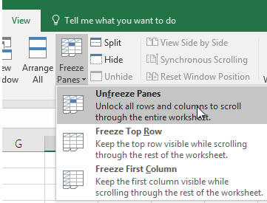
FREEZE PANE:
FREEZE PANE
When you freeze panes, Excel keeps specific rows or columns visible when you scroll in the worksheet.
Freeze the first column
Select View > Freeze Panes > Freeze First Column.
Freeze the first two columns
Select the third column.
Select View > Freeze Panes > Freeze Panes.
Freeze columns and rows
Select the cell below the rows and to the right of the columns you want to keep visible when you scroll.
Select View > Freeze Panes > Freeze Panes.
Unfreeze rows or columns
On the View tab > Window > Unfreeze Panes.

Slide 41
SELECTION OF CELL/RANGES OF CELL
A range of cell | Click the first cells of the range, and then drag to the last cell.
All cells on a worksheet | Click the select all button
Cell ranges | CTRL+ Mouse click at various cells
A large range of cells | SHIFT+ Mouse click at various cells
A large range of rows or column | SHIFT+ Mouse click at row or column labels or F8
A different range of rows or column | CTRL+ Mouse click at row or column labels

Slide 42
KEYS FOR MOVING AND SCROLLING IN A
WORKSHEET OR WORKBOOK
PRESS | TO
ARROW KEYS | MOVE ONE CELL UP, DOWN, LEFT OR RIGHT
CTRL + ARROW KEY | MOVE TO THE END OF THE CURRENT SHEET
HOME | MOVE TO THE BEGINNING OF THE ROW
CTRL + HOME | MOVE TO THE BEGINNING OF THE WORKSHEET
F11 | CREATE CHART OF CURRENT DATA ON SEPARATE TAB
CTRL+F10 | MAXIMISE OR RESTORE WINDOW
CTRL + END | MOVE TO THE LAST CELL ON THE WORKSHEET CONTENT
PAGE DOWN | MOVE DOWN ONE SCREEN
PAGE UP | MOVE UP ONE SCREEN
ALT + PAGE DOWN | MOVE ONE SCREEN TO THE RIGHT
ALT + PAGE UP | MOVE ONE SCREEN TO THE LEFT

Slide 43
KEYS FOR MOVING AND SCROLLING IN A
WORKSHEET OR WORKBOOK
PRESS | TO
CTRL + PAGE DOWN | MOVE TO THE NEXT SHEET IN THE WORKBOOK
CTRL + PAGE UP | MOVE TO THE PREVIOUS SHEET IN THE WORKBOOK
CTRL+F6 OR CTRL+TAB | MOVE TO THE NEXT WORKBOOK OR WINDOW
F5 | DISPLAY THE GO TO DIALOG BOX
SHIFT+F5 | DISPLAY THE FIND DIALOG BOX
ENTER | COMPLETE A CELL ENTRY AND MOVE DOWN
ALT+ENTER | START A NEW LINE IN THE SAME CELL
TAB | COMPLETE A CELL ENTRY AND MOVE TO THE RIGHT
SHIFT+TAB | COMPLETE A CELL ENTRY AND MOVE TO THE LEFT

Slide 44
KEYS FOR MOVING AND SCROLLING IN A
WORKSHEET OR WORKBOOK
PRESS | TO
ESC | CANCEL A CELL ENTRY
CTRL + D | FILL DOWN
CTRL + R | FILL TO THE RIGHT
SHIFT + F2 | EDIT A CELL COMMENTS
F2 | EDIT THE ACTIVE CELL
F7 | DISPLAY THE SPELLING DIALOG BOX

Slide 45
KEYS FOR ENTERING/ EDITING DATA
ON A WORKSHEET
PRESS | TO
CTRL + 1 | OPEN FORMAT CELL
CTRL + Q | QUICK ANALYSIS
CTRL + 8 | CREATE OUTLINE
CTRL + 9 | HIDE ROW
CTRL + 0 | HIDE COLUMN
CTRL + SHIFT+( | UNHIDE ROW
CTRL + SHIFT+) | UNHIDE COLUMN
CTRL + - | DELETE OPTION
CTRL+SHIFT+: | CURRENT TIME
CTRL+; | CURRENT DATE
CTRL+ALT+V | PASTE SPECIAL

Slide 46
KEYS FOR ENTERING/ EDITING DATA
ON A WORKSHEET
PRESS | TO
CTRL +SHIFT+ + | INSERT DIALOGUE BOX
CTRL + - | DELETE DIALOGUE BOX
CTRL + SHIFT +U | SWITCHES BETWEEN EXPANDING AND COLLAPSING OF THE FORMULA BAR
CTRL + D | COPIES THE VALUE FROM THE CELL ABOVE THE ACTIVE CELL INTO THE CELL OR THE FORMULA BAR
SHIFT +TAB | MOVES TO THE PREVIOUS CELL
SHIFT + SPACEBAR | SELECT ENTIRE ROW
CTRL + SPACEBAR | SELECT ENTIRE COLUMN
CTRL + SHIFT +L | REAPPLY THE FILTER AND SORT
SHIFT+ F11 | INSERT SHEET

Slide 47
KEYS FOR ENTERING/ EDITING DATA
ON A WORKSHEET
PRESS | TO
CTRL +SHIFT+ 7 | APPLY OUTLINE BORDER TO CELL
CTRL + SHIFT+_ | REMOVE OUTLINE BORDER FROM CELL
ALT+= | INSERT AUTOSUM FORMULA
CTRL+SHIFT+P | SHOWS FONT TAB OF FORMAT CELL
CTRL+L | DISPLAY CREATE TABLE OPTION
CTRL+] | SELECT CELLS THAT CONTAIN FORMULAS THAT DIRECTLY REFERENCE THE ACTIVE CELL
CTRL+E | FLASH FILL
CTRL+W | CLOSE ACTIVE SHEET

Slide 48
VALIDATION OF DATA
Excel Data Validation is a feature that restricts (validates) user input to a worksheet. Technically, you create a validation rule that controls what kind of data can be entered into a certain cell. Like
Allow only numeric or text values in a cell.
Allow only numbers within a specified range.
Allow data entries of a specific length.
Restrict dates and times outside a given range.
Restrict entries to a selection from a drop-down list.
Validate an entry based on another cell.
Show an input message when the user selects a cell.
Show a warning message when incorrect data has been entered.
Find incorrect entries in validated cells.

Slide 49
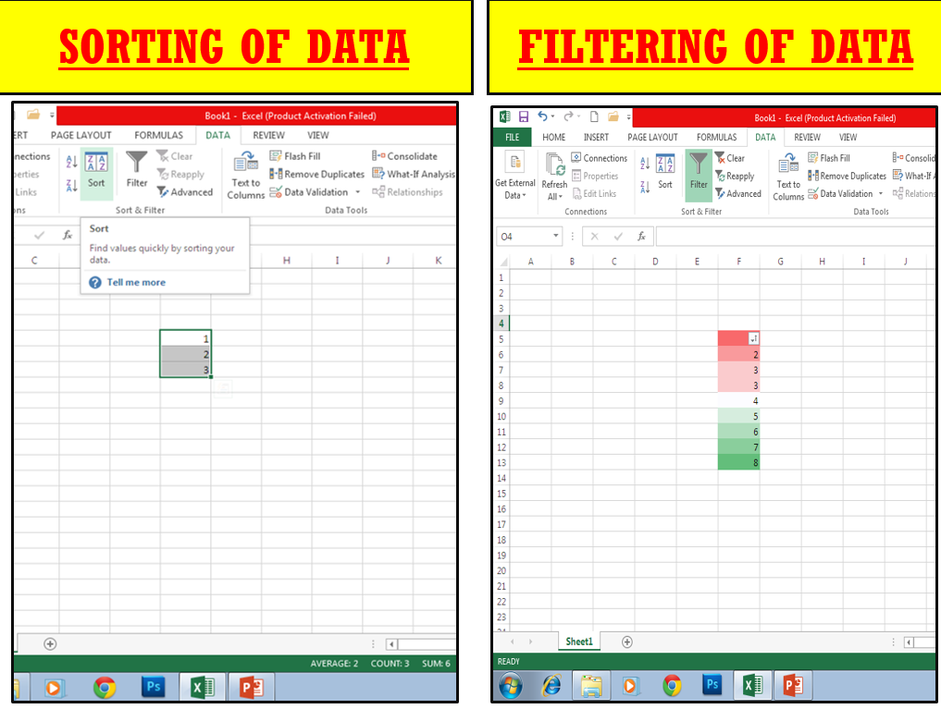
SORTING & FILTERING OF DATA
The filter tool gives you the ability to filter a column of data within a table to isolate the key components you need. The sorting tool allows you to sort by date, number, alphabetic order and more.

Slide 50
WHAT IS CHART
A chart is a visual representative of data in both columns and rows.
Charts are also known as graphs.
A chart is essentially an object that excel creates upon request. This object consists of one or more data series, displayed graphically.
Charts are dynamic. In other words, a chart series is linked to the data in your worksheet. It gets change when the chart is updated to reflect those changes.

Slide 51
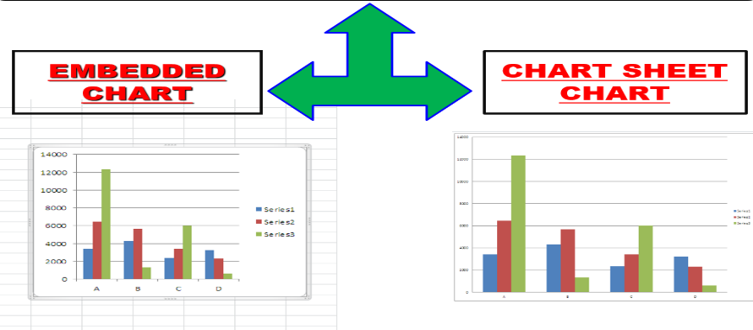
CLASSIFICATION OF CHARTS
  Embedded charts
    Alt+f1 to create an embedded chart
  Chart sheet chart
    F11 to create a chart sheet chart.

Slide 52
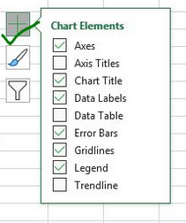
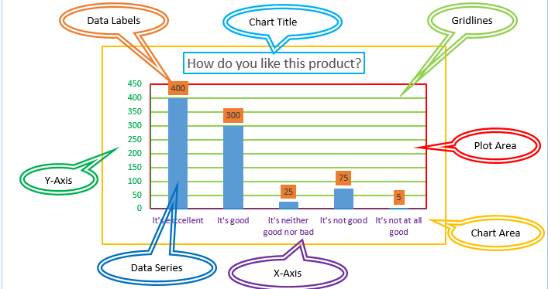
ELEMENTS OF CHART

Slide 53
TYPES OF CHART
Column chart.
Line chart.
Pie or doughnut chart.
Bar chart.
Area chart.
X y (scatter) chart.
Stock.
Surface chart.
Bubble.
Radar.
Tree map
Sunbrust
Histogram
Box & whisker
Waterfall
Funnel
Combo

Slide 54
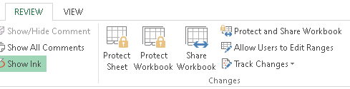
SECURITY OF DATA
SECURITY OF DATA:
Excel sheet can be secure by the following method applied.
Encryption document
File protection
Worksheet protect
Workbook protect

